Slide 1



Unlock Real-Time AI-ML
Event Streaming
with Spring and Cloud Native Data Services

Slide 2
Goal
What is AI/ML?
Agenda
Technologies Spring & Data Services
Cloud Native Architecture
Conclusion

Slide 3
Goal
How can we understand information to make informed decisions quicker?

Slide 4

Information
Letter
Email
Text
Message…

Slide 5
Is this information
Good or Bad?
Is this Real?
Information
Letter
Email
Text
Message…
Is this information Dangerous?

Slide 6
Artificial
Intelligence
(AI)
Information
Letter
Email
Text
Message…

Slide 7
What is Artificial Intelligence (AI)?
AI is technology that emulates human intelligence

Slide 8
What is Machine Learning (ML)?
ML is artificial intelligence that uses mathematical data algorithms

Slide 9
AI
AI
Is this information
Good or Bad?
Sentiment Analysis
Is this Real?
Fraud Detection
Information
Letter
Email
Text
Message…
Is this information Dangerous?
Threat
Detection

Slide 10
Main Idea
AI
AI/ML can help humans understand information to make informed decisions quicker using Models
ML

Slide 11
What is a ML Model?
A Model is a Machine learning mathematical algorithm that is trained to produce an outcome
Model

Slide 12
Model algorithms are base supervised, unsupervised , or reinforcement learning
How do ML Models learn?
Model
<Supervised>
Model
<Reinforcement>
Model
<Unsupervised>
hidden Markov
k-means
hierarchical clustering
Gaussian mixture
temporal difference
deep adversarial networks
Q-learning
neural networks
decision trees
linear regression

Slide 13
AI Models Algorithm - categories
Classification
Classification is a ML model algorithm to associate data by a category
Anomaly
Anomaly is a ML model algorithm to identify deviation for normal trends
Regression
Regression is a ML model algorithm to predict outputs
Clustering
Clustering is ML model algorithm to group similar data points

Slide 14
Sentiment Analysis
Classification
Classification is a ML model algorithm to associate data by a category
Fraud Detection
Information
Letter
Email
Text
Message…
Threat
Detection

Slide 15
Inferencing
Inferencing refers to providing a Model input that produce output based on training data
Information
Model
Letter
Email
Text
Message…
Output=Sentiment Analysis
Input=

Slide 16
Models are provided with training data that is labeled to predict future outcomes based on data trend
How are models trained?
Model
Example Supervised ML Training Data
Text: "I absolutely love The Chosen series! The messaging is incredible, and it made me cry a couple of times." Sentiment: Positive
Text: "The grocery prices are so expensive. The cost of my favorites like fruits and chicken are so disappointing." Sentiment: Negative
Text: "I had a mixed experience at the restaurant. The food was good, but the service was very slow." Sentiment: Neutral
Text: "This book was for real! It had me shocked one minute and laughing the next." Sentiment: Positive
Text: "The customer support team was pretty rude. I cannot say I look forward to shopping there again." Sentiment: Negative

Slide 17

Large Language Models (LLM) support multiple categories of usage and are trained on enormous amounts of data such as information from the internet
Model LLM

Slide 18


Can I use existing models?
Online Platforms like OpenAI
with ChatGPT and Hugging Face and others have made it easy to use the power of AI in existing Models
ChatGPT
<unsupervised>
Model(s)
FREE!

Slide 19
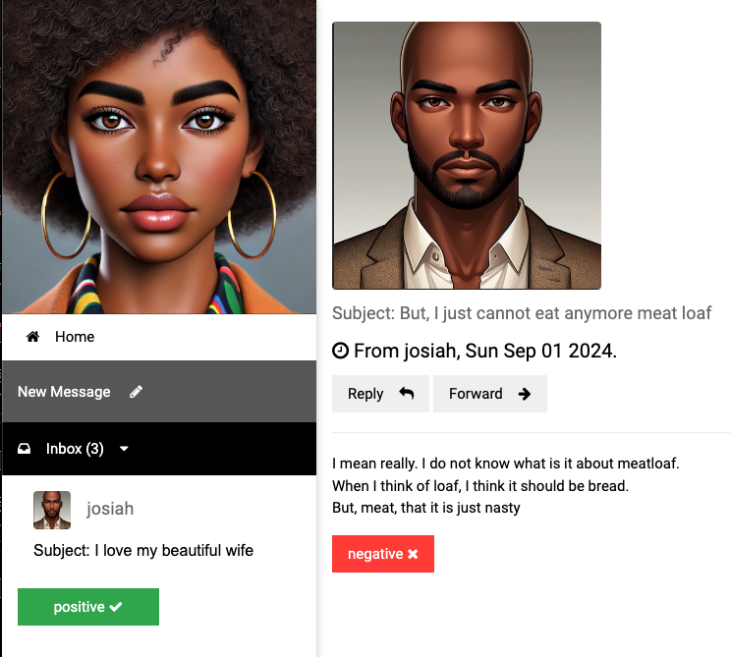
Sentiment Analysis

Slide 20
Getting started with AI/ML
Vector Embedding is a numerical representation of data
App(s)
=>
I love my awesome wife, she is my best friend
[ -0.5539689660072327, -0.04552192986011505, 0.2843276858329773, 0.12018735706806183, -0.4164251685142517, -0.0015744016272947192,
0.8378576636314392, -0.2455213963985443,
0.1919904500246048, 0.3389095067977905, 0.5132707357406616, -0.5949105024337769, -0.05128718167543411, 0.13099819421768188, 0.23817287385463715, 0.16531096398830414, -0.08132422715425491,,… ]

Slide 21
How are vector embeddings generated?
Text Embedding produces vector embedding based on text input
Model
<text-embedding>
App(s)
[ -0.5539689660072327, -0.04552192986011505, 0.2843276858329773, 0.12018735706806183, -0.4164251685142517, -0.0015744016272947192,
0.8378576636314392, -0.2455213963985443,
0.1919904500246048, 0.3389095067977905, 0.5132707357406616, -0.5949105024337769, -0.05128718167543411, 0.13099819421768188, 0.23817287385463715, 0.16531096398830414, -0.08132422715425491,,… ]
I love my awesome wife, she is my best friend
=>

Slide 22
How to perform sentiment analysis?
Model
<text-classification>
Model
<embedding>
App(s)
Text classification determines sentiment such as
-2=VERY_NEGATIVE, -1=NEGATIVE, 0=NEUTRAL,
1=POSITIVE 2=VERY_POSTIVE
Vector embedding
[ -0.5539689660072327, -0.04552192986011505, 0.2843276858329773, 0.12018735706806183, -0.4164251685142517, -0.0015744016272947192,
0.8378576636314392, -0.2455213963985443,
0.1919904500246048, 0.3389095067977905, 0.5132707357406616, -0.5949105024337769, -0.05128718167543411, 0.13099819421768188, 0.23817287385463715, 0.16531096398830414, -0.08132422715425491,,… ]
=>
=>
I love my awesome wife, she is my best friend

Slide 23

How to perform sentiment analysis?
Models
Spring AI
App(s)
Spring AI simplifies the use of ML models from libraries like Hugging Face and OpenAI for Java programing applications
I love my awesome wife

Slide 24


How can apps receive data for sentiment analysis?
Event brokers provides real-time information event streaming
Spring AI
App(s)
Event Broker

Slide 25
Why would you use RabbitMQ?
RabbitMQ streams
can support replay messages for training
RabbitMQ streams can support millions of messages per second for inferencing
Event
Broker

Slide 26


How to store data?
A Database can store information to act as a system of record or an operational data store for data access
Database

Slide 27

How to learn from stored data?
Model
LLM(s)
Vector databases integrate data for Large Language models (LLM) with similar data as context to provide better outcomes (also known as Retrieval Augmented Generation (RAG).
<Vector>
Database

Slide 28
How to learn from stored data?
Model
LLM(s)
<Vector>
Database

Slide 29

How to get results faster?
A Cache provides fast access to in-memory
most frequently used data information
Cache

Slide 30


Models
Models
Consumer Sink App
User
App
Event Processor
App
Data Services
Postgres ML
ValKey
RabbitMQ

Slide 31
Cloud Platform
Models
Models
Public or private Cloud platforms allow to easily scale AI/ML training and interference based on the volume of data and users
Event Processor
App
Consumer Sink App
User
App
Data Services
Postgres
RabbitMQ
ValKey

Slide 32



Cloud Native platforms
Cloud Native platforms like Kubernetes and Cloud Foundry simplify the deployment of applications and data services
Apps
Event Broker
Cache
Database

Slide 33
How do cloud platforms simplify deployments?
A Container is a lightweight, package of software that contains everything needed to run apps and data services on a cloud platform
Container
Container
Container
Container

Slide 34
Cloud platforms like Kubernetes and Cloud Foundry provide provisioning, auto healing and scalability for Spring apps and data services like RabbitMQ, Postgres and ValKey running in containers
Models
Models
Event Processor
App
Consumer Sink App
User
App
Data Services
Postgres
RabbitMQ
ValKey

Slide 35
Conclusion
Goal: How can we understand information to make informed decisions quicker?
AI/ML
Help you to understand information based on mathematically algorithm models
Spring
Simplifies the use of ML models for Java programming applications for informed outcome-based decisions
Cloud Data Services
Cloud native platforms make it easy to run scalable services. Event streaming brokers like RabbitMQ provide real-time information, Vector databases like Postgres to improve model accuracy and caching services like ValKey provide faster data access anywhere.

Slide 36


Gregory Green
VMware By Broadcom
Connect with me on
LinkedIn
Demo
Source
Code

